Slide 1















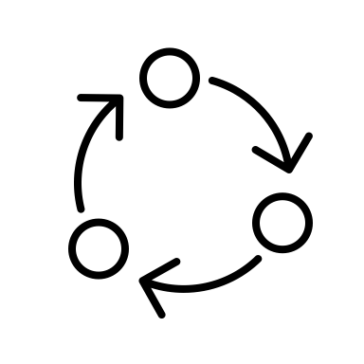


Sentiment Analysis using Python
THAO TRAN (★★★★★)
_______________________________________________________
_______________________________________________________
______________________________________________________
THU TRAN (★★★)
_______________________________________________________
_______________________________________________________
______________________________________________________
HUITING WU (★★★★)
_______________________________________________________
_______________________________________________________
______________________________________________________
HOME
INFO
DATAC
OVERVIEW
VISUAL
PROCESS
TRAIN
RESULTS

Slide 2
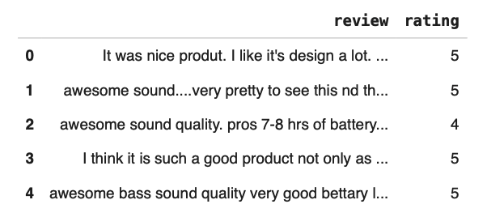
DATASET
General information:
Contains 2 variables: Reviews and its corresponding Ratings which given by the users on Flipkart.
Reviews are strings; Ratings are scales by 1 to 5
Goal:
To predict whether the review given is positive or negative
Method:
Machine Learning (Decision Tree)
Sentiment Analysis using Python
Flipkart is primarily known as an online marketplace where customers can browse, select, and purchase a diverse array of products.
Flipkart Private Limited is an Indian e-commerce company.
The company initially focused on online book sales before expanding into other product categories such as consumer electronics, fashion, home essentials, groceries, and lifestyle products.
As of March 2017, Flipkart held a 39.5% market share in the Indian e-commerce industry.
First 5 lines from data
THAO TRAN (★★★★★)
_______________________________________________________
_______________________________________________________
______________________________________________________
THU TRAN (★★★)
_______________________________________________________
_______________________________________________________
______________________________________________________
HUITING WU (★★★★)
_______________________________________________________
_______________________________________________________
______________________________________________________
INFO
HOME
DATAC
OVERVIEW
VISUAL
PROCESS
TRAIN
RESULTS

Slide 3
DATASET
PYTHON LIBRARY
General information:
Contains 2 variables: Reviews and its corresponding Ratings which given by the users on Flipkart.
Reviews are strings; Ratings are scales by 1 to 5
Goal:
To predict whether the review given is positive or negative
Method:
Machine Learning (Decision Tree)
Import the data:
Pandas : For importing the dataset.
Machine Learning Model:
Scikit-learn : For importing the model, accuracy module, and TfidfVectorizer. (Decision Tree Model & Confusion matrix)
Warning : To ignore all the warnings
Data Visualization:
Matplotlib : To plot the visualization. (Word Cloud)
Seaborn : data visualization library based on matplotlib. (Bar plot)
Preprocessing Text:
NLTK: For text analysis; It contains text processing libraries for tokenization, parsing, classification, stemming, tagging and semantic reasoning. Using the stop words and punctuations library and tokenization in this project.
Re: let you check if a particular string matches a given regular expression.
First 5 lines from data
Flipkart is primarily known as an online marketplace where customers can browse, select, and purchase a diverse array of products.
Flipkart Private Limited is an Indian e-commerce company.
The company initially focused on online book sales before expanding into other product categories such as consumer electronics, fashion, home essentials, groceries, and lifestyle products.
As of March 2017, Flipkart held a 39.5% market share in the Indian e-commerce industry.
DATA
HOME
INFO
OVERVIEW
VISUAL
PROCESS
TRAIN
RESULTS

Slide 4

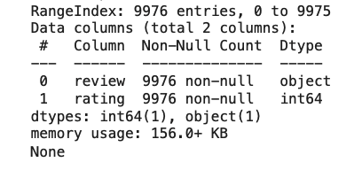
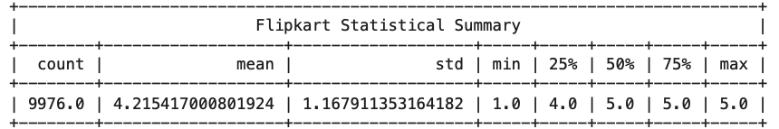
PYTHON LIBRARY
OVERVIEW
General information:
Contains 2 variables: Reviews and its corresponding Ratings which given by the users on Flipkart.
Reviews are strings; Ratings are scales by 1 to 5
Goal:
To predict whether the review given is positive or negative
Method:
Machine Learning (Decision Tree)
Import the data:
Pandas : For importing the dataset.
Machine Learning Model:
Scikit-learn : For importing the model, accuracy module, and TfidfVectorizer. (Decision Tree Model & Confusion matrix)
Warning : To ignore all the warnings
Data Visualization:
Matplotlib : To plot the visualization. (Word Cloud)
Seaborn : data visualization library based on matplotlib. (Bar plot)
Preprocessing Text:
NLTK: For text analysis; It contains text processing libraries for tokenization, parsing, classification, stemming, tagging and semantic reasoning. Using the stop words and punctuations library and tokenization in this project.
Re: let you check if a particular string matches a given regular expression.
Data information (checking missing value)
First 5 lines from data
Descriptive statistical measures
DATA
HOME
INFO
OVERVIEW
VISUAL
PROCESS
TRAIN
RESULTS

Slide 5
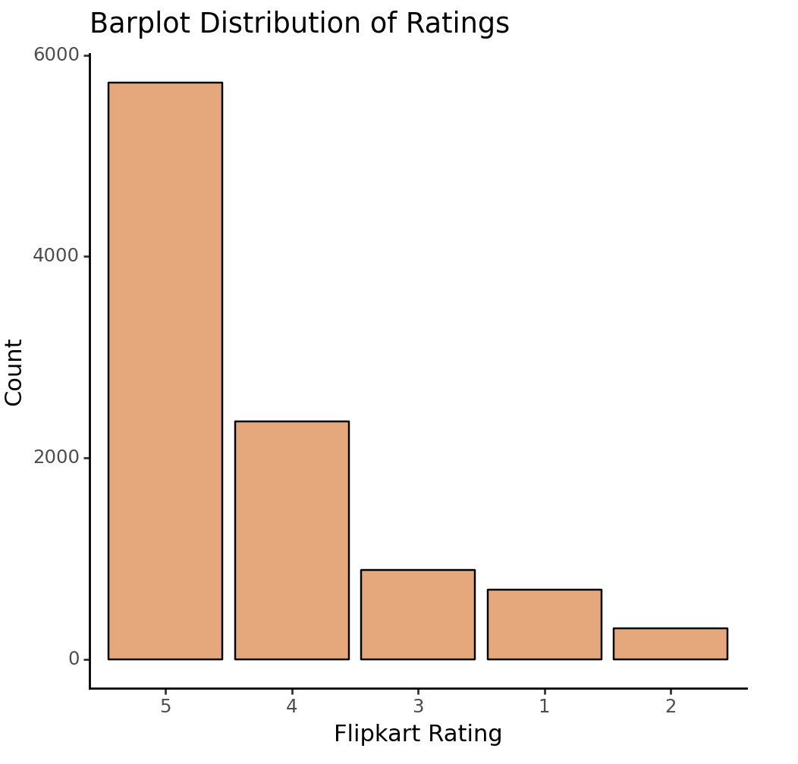
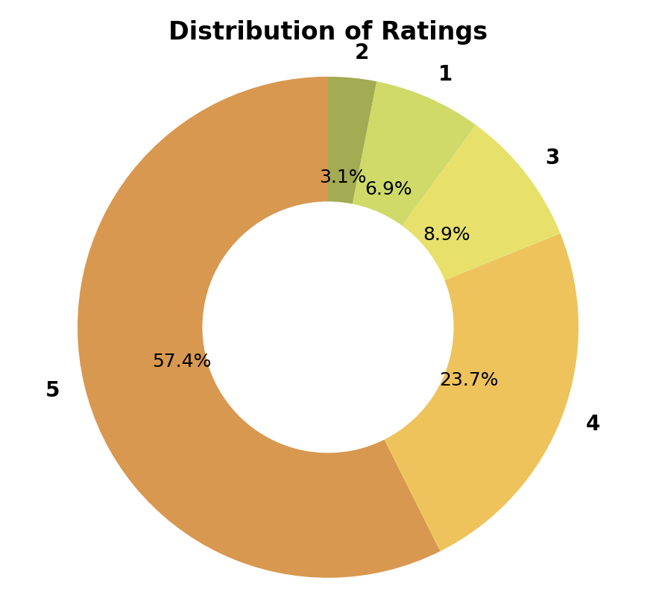
OVERVIEW
VISUAL
Import the data:
Pandas : For importing the dataset.
Machine Learning Model:
Scikit-learn : For importing the model, accuracy module, and TfidfVectorizer. (Decision Tree Model & Confusion matrix)
Warning : To ignore all the warnings
Data Visualization:
Matplotlib : To plot the visualization. (Word Cloud)
Seaborn : data visualization library based on matplotlib. (Bar plot)
Preprocessing Text:
NLTK: For text analysis; It contains text processing libraries for tokenization, parsing, classification, stemming, tagging and semantic reasoning. Using the stop words and punctuations library and tokenization in this project.
Re: let you check if a particular string matches a given regular expression.
Data information (checking missing value)
Descriptive statistical measures
OVERVIEW
HOME
INFO
DATAC
VISUAL
PROCESS
TRAIN
RESULTS

Slide 6
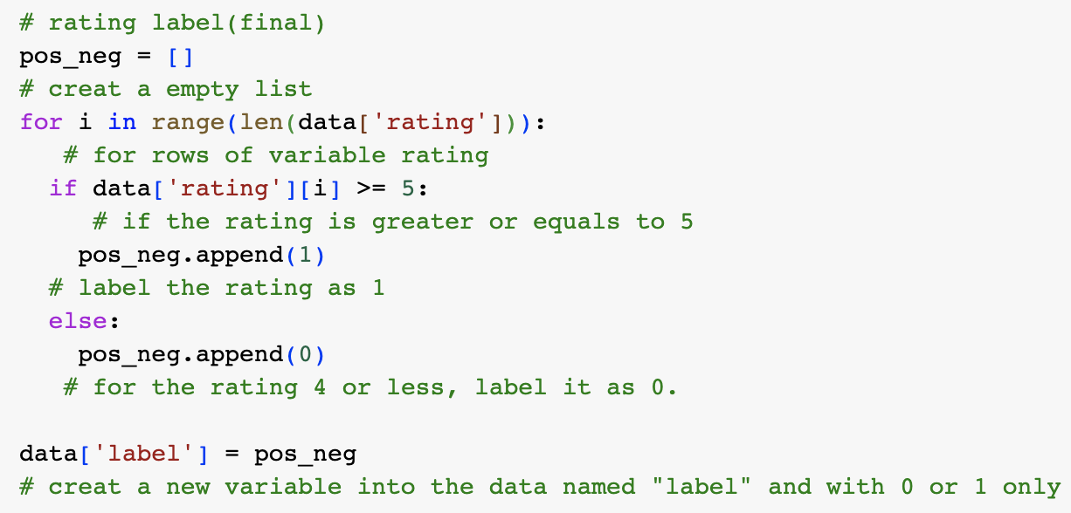
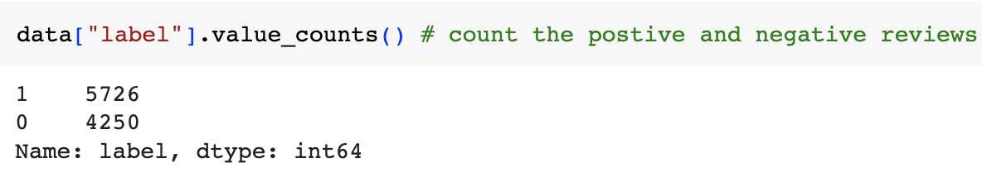
OVERVIEW
VISUAL
Data information (checking missing value)
Labeling
Descriptive statistical measures
Counting the ‘label’
GENERAL
ANALYSIS
HOME
INFO
DATAC
OVERVIEW
PROCESS
TRAIN
RESULTS

Slide 7
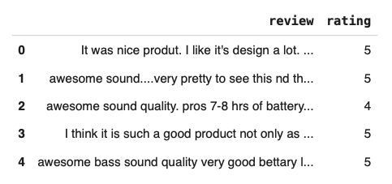
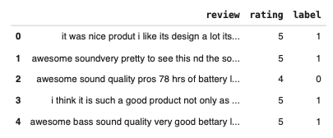
VISUAL
Labeling
Before label
After label
Counting the ‘label’
GENERAL
ANALYSIS
HOME
INFO
DATAC
OVERVIEW
PROCESS
TRAIN
RESULTS

Slide 8
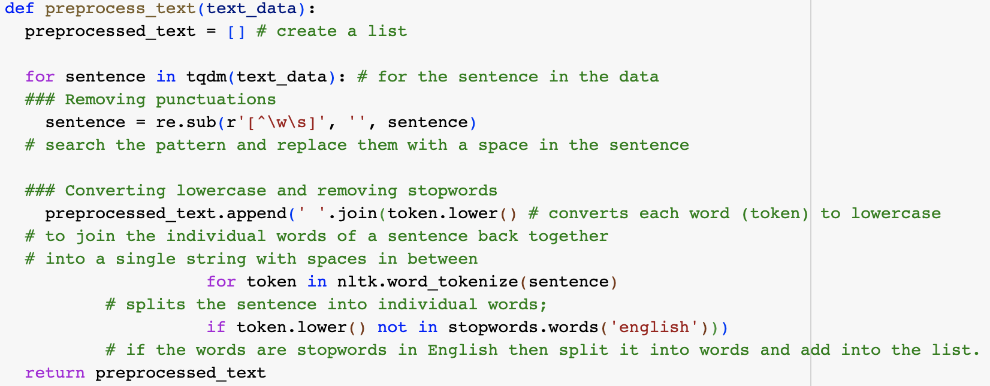
Preprocessing text
Labeling
Before label
After label
Counting the ‘label’
GENERAL
ANALYSIS
HOME
INFO
DATAC
OVERVIEW
PROCESS
TRAIN
RESULTS

Slide 9
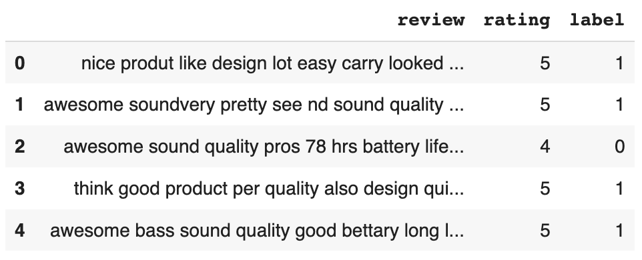
Preprocessing text
Before label
After label
Before preprocessing
After preprocessing
GENERAL
ANALYSIS
HOME
INFO
DATAC
OVERVIEW
PROCESS
TRAIN
RESULTS

Slide 10
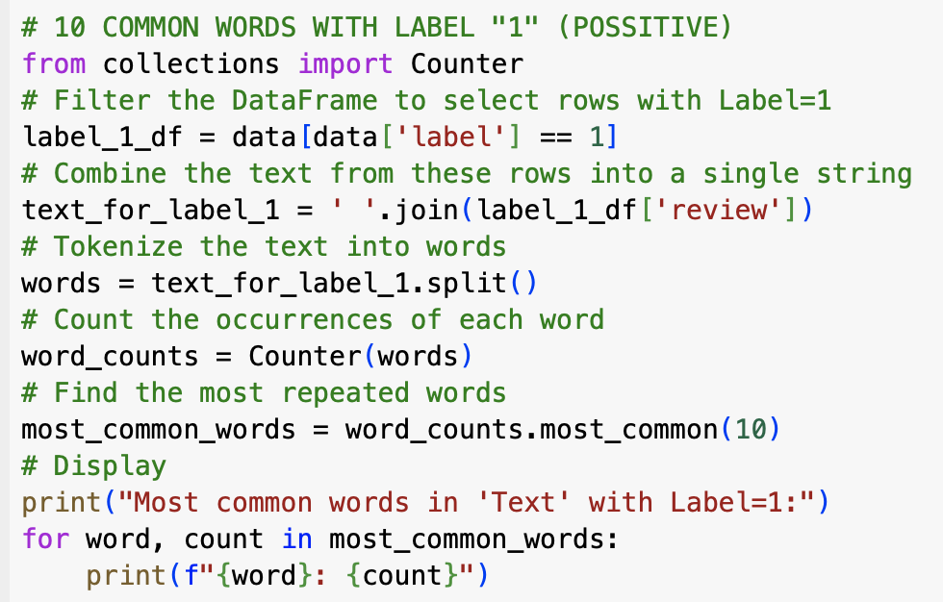
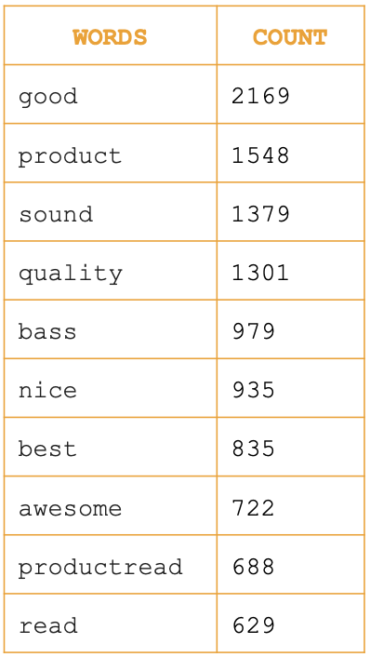
Preprocessing text
10 common words with label “1” ( Positive review)
Before preprocessing
After preprocessing
The dataset has drop 2717 lines which is almost 1/3 of the initial one
GENERAL
ANALYSIS
HOME
INFO
DATAC
OVERVIEW
PROCESS
TRAIN
RESULTS

Slide 11
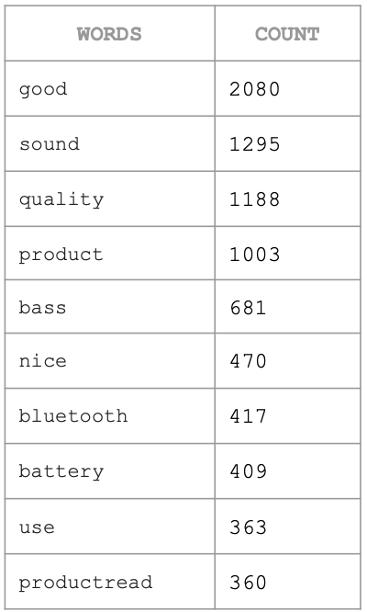
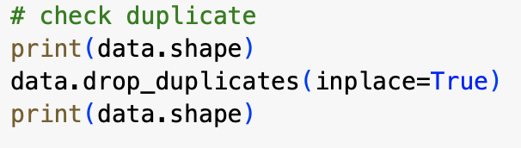
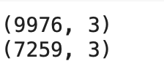
Drop duplicate
10 common words with label “1” ( Positive review)
Positive words
Negative words
NOTE:
Some words has been repeated in both “positive” and “negative” words, such as : “good”, “product”, “quality”.... since we consider 4 stars rating as a negative review. Besides that, people can use “not”, “ no” …in front of positive word to describe their thought.
The dataset has drop 2717 lines which is almost 1/3 of the initial one
GENERAL
ANALYSIS
HOME
INFO
DATAC
OVERVIEW
PROCESS
TRAIN
RESULTS

Slide 12
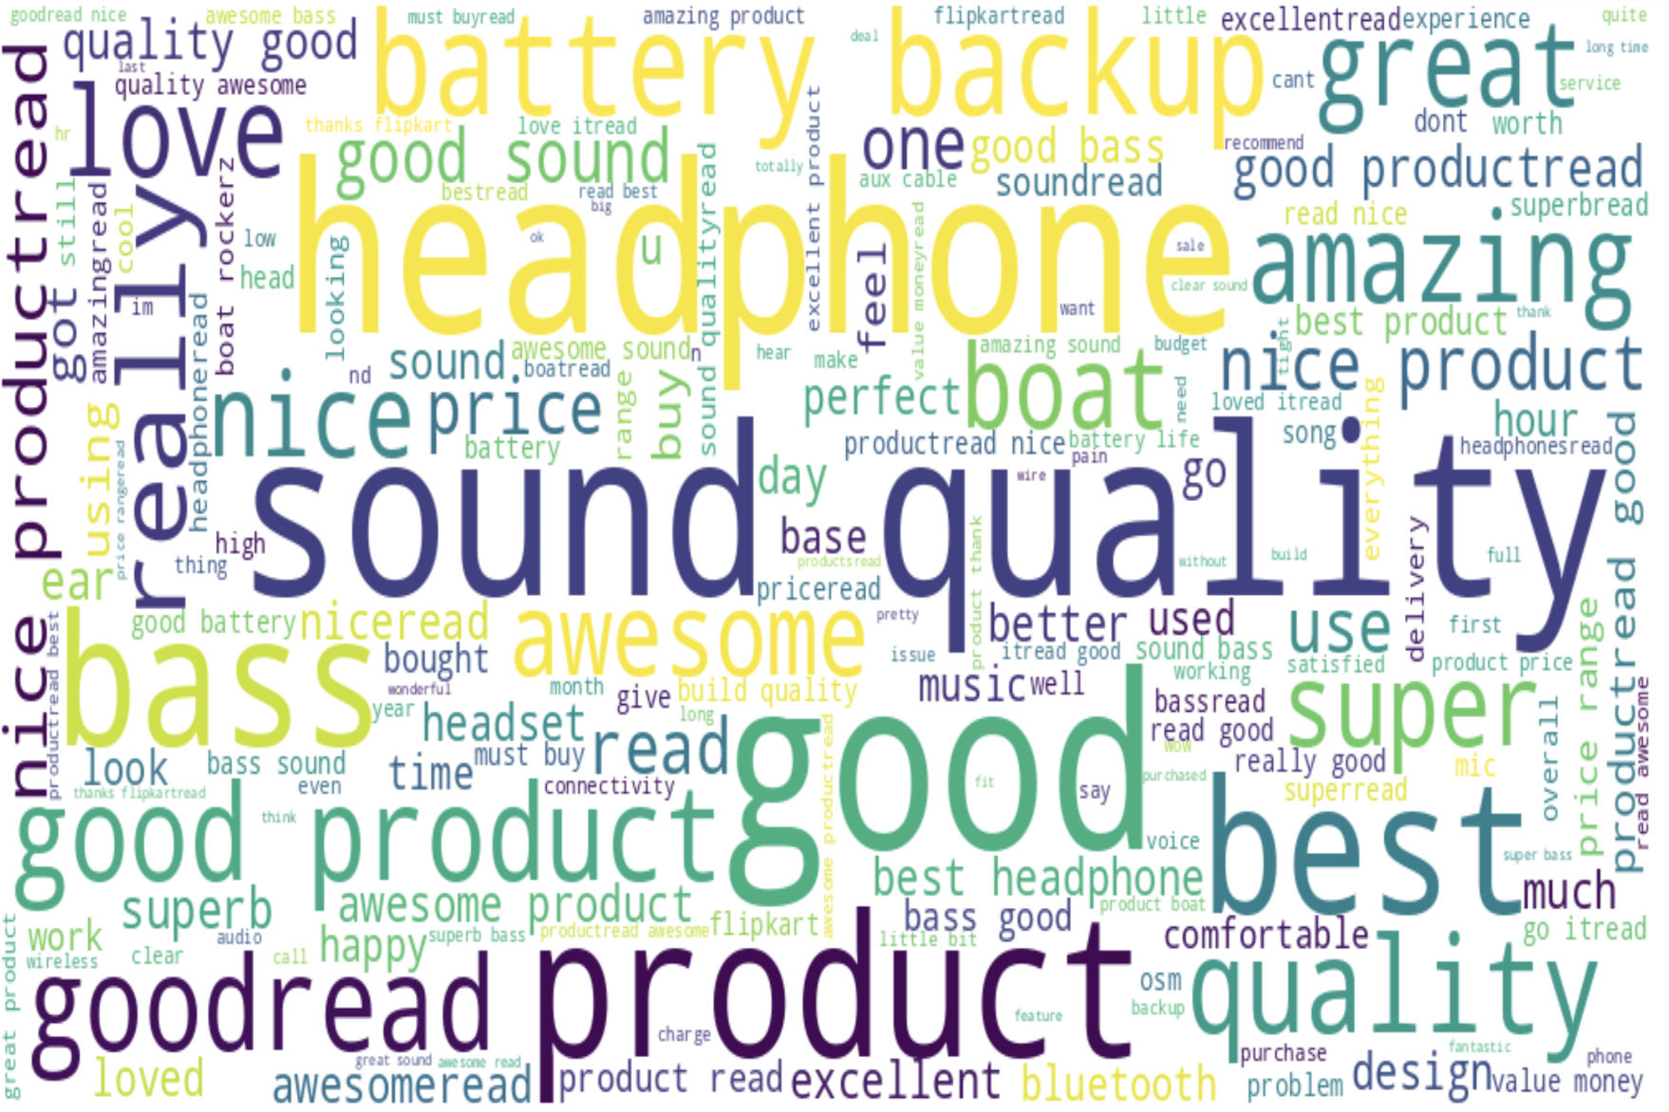
10 common words with label “1” ( Positive review)
Words cloud visual (Positive reviews)
Positive words
Negative words
NOTE:
Some words has been repeated in both “positive” and “negative” words, such as : “good”, “product”, “quality”.... since we consider 4 stars rating as a negative review. Besides that, people can use “not”, “ no” …in front of positive word to describe their thought.
GENERAL
ANALYSIS
HOME
INFO
DATAC
OVERVIEW
PROCESS
TRAIN
RESULTS

Slide 13
CONVERT TEXT TO NUMBER
Words cloud visual (Positive reviews)
Positive words
Negative words
NOTE:
Some words has been repeated in both “positive” and “negative” words, such as : “good”, “product”, “quality”.... since we consider 4 stars rating as a negative review. Besides that, people can use “not”, “ no” …in front of positive word to describe their thought.
Computers Prefer Numbers:
Machines understand numbers, not words. Converting text into numbers makes it easier for computers to process information.
Mathematics for Learning:
Numeric representations allow machines to use math to recognize patterns efficiently, aiding in the learning process for tasks like prediction and classification.
Efficiency and Prediction:
Converting text to numbers speeds up computations, making machine learning models more efficient. This numeric understanding helps machines predict outcomes and make decisions based on data.
GENERAL
ANALYSIS
HOME
INFO
DATAC
OVERVIEW
PROCESS
TRAIN
RESULTS

Slide 14
CONVERT TEXT TO NUMBER
TF-IDF SCORE (Term Frequency-Inverse Document Frequency)
Words cloud visual (Positive reviews)
Computers Prefer Numbers:
Machines understand numbers, not words. Converting text into numbers makes it easier for computers to process information.
Mathematics for Learning:
Numeric representations allow machines to use math to recognize patterns efficiently, aiding in the learning process for tasks like prediction and classification.
Efficiency and Prediction:
Converting text to numbers speeds up computations, making machine learning models more efficient. This numeric understanding helps machines predict outcomes and make decisions based on data.
TF-IDF measures word importance. "TF" counts word frequency in a document, and "IDF" considers how unique a word is across all documents.
A higher TF-IDF score suggests that a term is more important or relevant within a specific document.
It helps identify terms that are distinctive and carry meaningful information within the context of that document.
PROCESS
HOME
INFO
DATAC
OVERVIEW
VISUAL
TRAIN
RESULTS

Slide 15
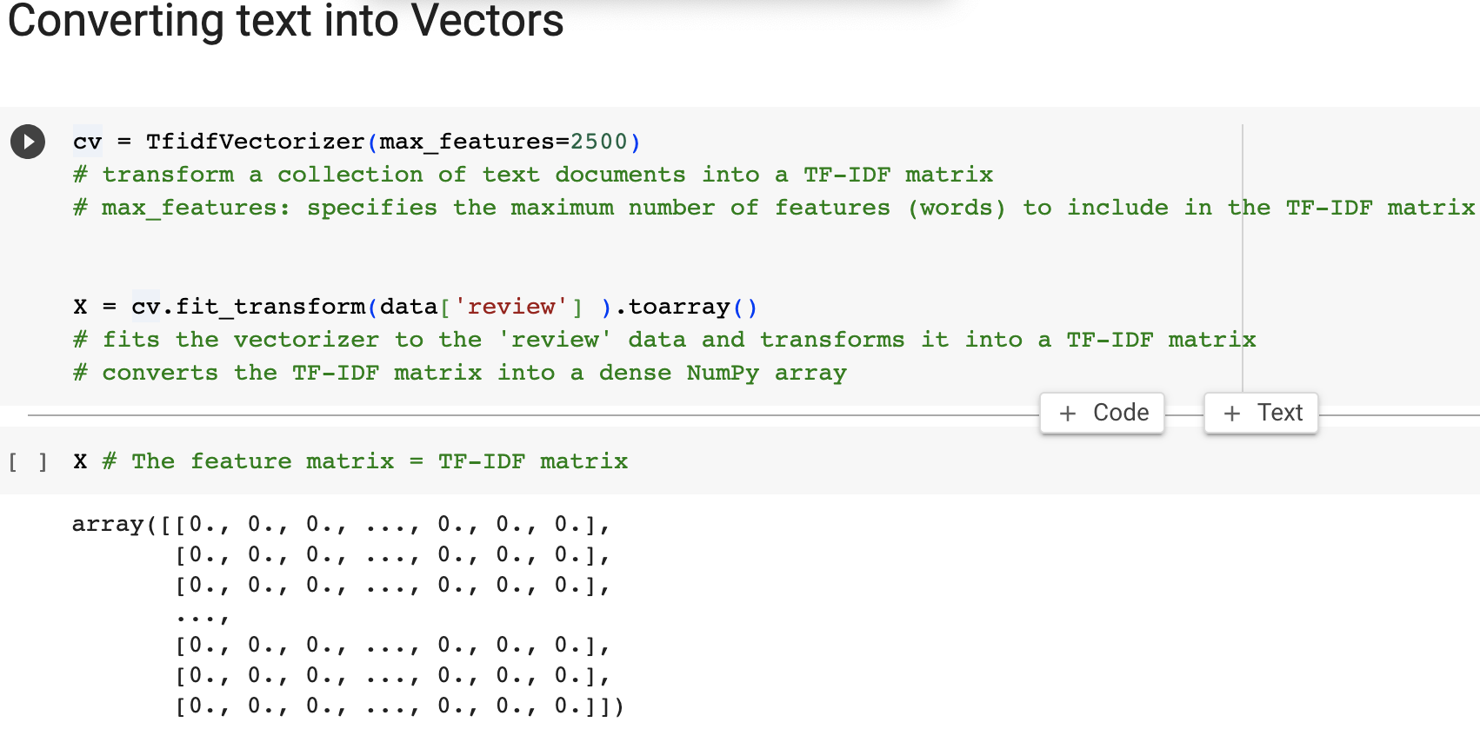
CONVERT TEXT TO NUMBER
TF-IDF SCORE (Term Frequency-Inverse Document Frequency)
Computers Prefer Numbers:
Machines understand numbers, not words. Converting text into numbers makes it easier for computers to process information.
Mathematics for Learning:
Numeric representations allow machines to use math to recognize patterns efficiently, aiding in the learning process for tasks like prediction and classification.
Efficiency and Prediction:
Converting text to numbers speeds up computations, making machine learning models more efficient. This numeric understanding helps machines predict outcomes and make decisions based on data.
TF-IDF measures word importance. "TF" counts word frequency in a document, and "IDF" considers how unique a word is across all documents.
A higher TF-IDF score suggests that a term is more important or relevant within a specific document.
It helps identify terms that are distinctive and carry meaningful information within the context of that document.
Feature matrix
MACHINE
LEARNING
HOME
INFO
DATAC
OVERVIEW
VISUAL
PROCESS
RESULTS

Slide 16
TF-IDF SCORE (Term Frequency-Inverse Document Frequency)
TF-IDF SCORE (Term Frequency-Inverse Document Frequency)
DATA SPLITING
Training Set:
Model learns patterns and relationships.
Like a practice ground for the model.
Test Set:
Evaluates how well the model applies learning.
Simulates real-world scenarios with new, unseen data.
Why Split?
Ensures model can handle new situations.
Prevents overfitting by avoiding memorization of specific data.
Evaluation:
Metrics like accuracy assess model performance.
Allows adjustments for better predictions.
TF-IDF measures word importance. "TF" counts word frequency in a document, and "IDF" considers how unique a word is across all documents.
A higher TF-IDF score suggests that a term is more important or relevant within a specific document.
It helps identify terms that are distinctive and carry meaningful information within the context of that document.
Feature matrix
MACHINE
LEARNING
HOME
INFO
DATAC
OVERVIEW
VISUAL
PROCESS
RESULTS

Slide 17
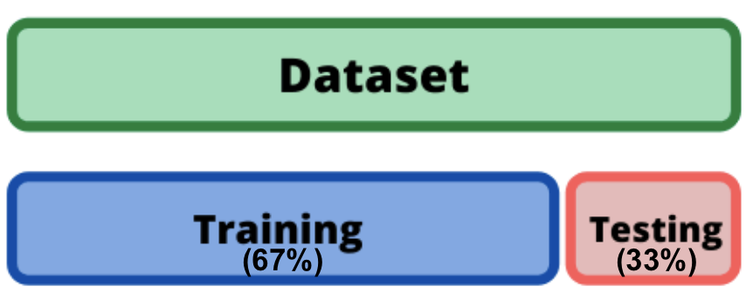
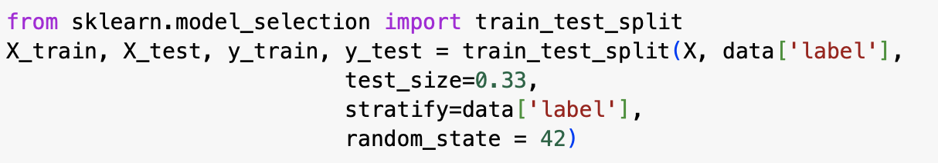
TF-IDF SCORE (Term Frequency-Inverse Document Frequency)
DATA SPLITING
Training Set:
Model learns patterns and relationships.
Like a practice ground for the model.
Test Set:
Evaluates how well the model applies learning.
Simulates real-world scenarios with new, unseen data.
Why Split?
Ensures model can handle new situations.
Prevents overfitting by avoiding memorization of specific data.
Evaluation:
Metrics like accuracy assess model performance.
Allows adjustments for better predictions.
Feature matrix
MACHINE
LEARNING
HOME
INFO
DATAC
OVERVIEW
VISUAL
PROCESS
RESULTS

Slide 18
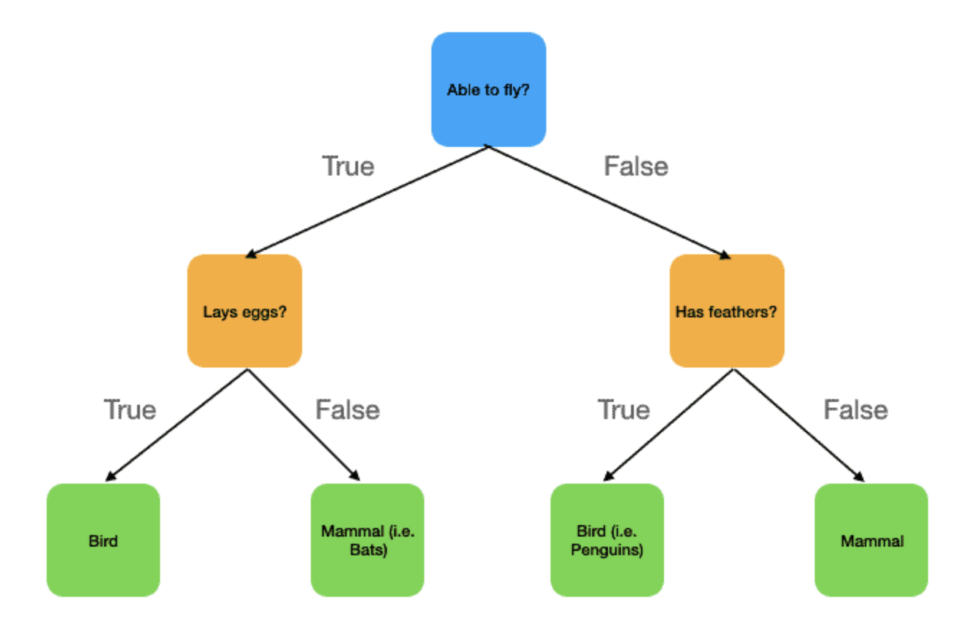
DATA SPLITING
DATA SPLITING
DECISION TREE
Training Set:
Model learns patterns and relationships.
Like a practice ground for the model.
Test Set:
Evaluates how well the model applies learning.
Simulates real-world scenarios with new, unseen data.
Why Split?
Ensures model can handle new situations.
Prevents overfitting by avoiding memorization of specific data.
Evaluation:
Metrics like accuracy assess model performance.
Allows adjustments for better predictions.
A powerful machine learning algorithm for classification and regression tasks.
A family of non-parametric supervised learning models
Can be applied to both classification and regression problems.
EXAMPLE OF DECISION TREE
Root node: (BLUE)
Starting point of the decision tree.
Represents the entire dataset.
Interior nodes: (ORANGE)
Decision-making point within the tree.
Poses a question or condition based on a feature.
Leaf nodes: (GREEN)
End point of a decision tree branch.
Provides the final prediction or outcome.
MACHINE
LEARNING
HOME
INFO
DATAC
OVERVIEW
VISUAL
PROCESS
RESULTS

Slide 19
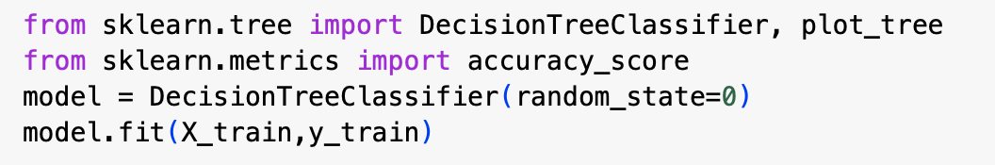
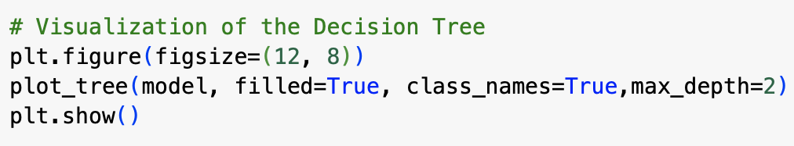
DATA SPLITING
DECISION TREE
Fitting data with Decision Tree model
A powerful machine learning algorithm for classification and regression tasks.
A family of non-parametric supervised learning models.
EXAMPLE OF DECISION TREE
Root node: (BLUE)
Starting point of the decision tree.
Represents the entire dataset.
Interior nodes: (ORANGE)
Decision-making point within the tree.
Poses a question or condition based on a feature.
Leaf nodes: (GREEN)
End point of a decision tree branch.
Provides the final prediction or outcome.
Visual Decision Tree model
MACHINE
LEARNING
HOME
INFO
DATAC
OVERVIEW
VISUAL
PROCESS
RESULTS

Slide 20
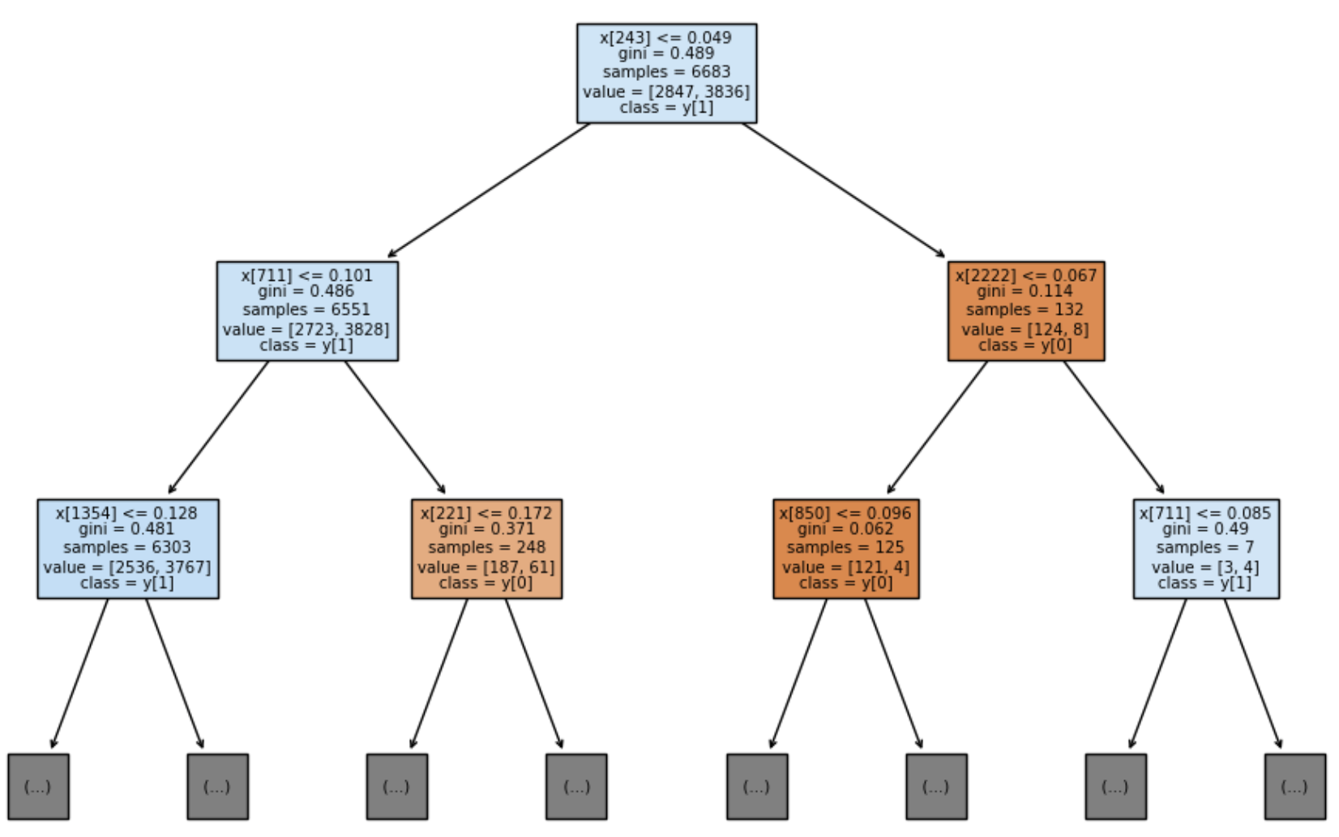
DECISION TREE
A powerful machine learning algorithm for classification and regression tasks.
A family of non-parametric supervised learning models
Can be applied to both classification and regression problems.
Fitting data with Decision Tree model
Flipkart Decision Tree
EXAMPLE OF DECISION TREE
Root node: (BLUE)
Starting point of the decision tree.
Represents the entire dataset.
Interior nodes: (ORANGE)
Decision-making point within the tree.
Poses a question or condition based on a feature.
Leaf nodes: (GREEN)
End point of a decision tree branch.
Provides the final prediction or outcome.
Visual Decision Tree model
MACHINE
LEARNING
HOME
INFO
DATAC
OVERVIEW
VISUAL
PROCESS
RESULTS

Slide 21
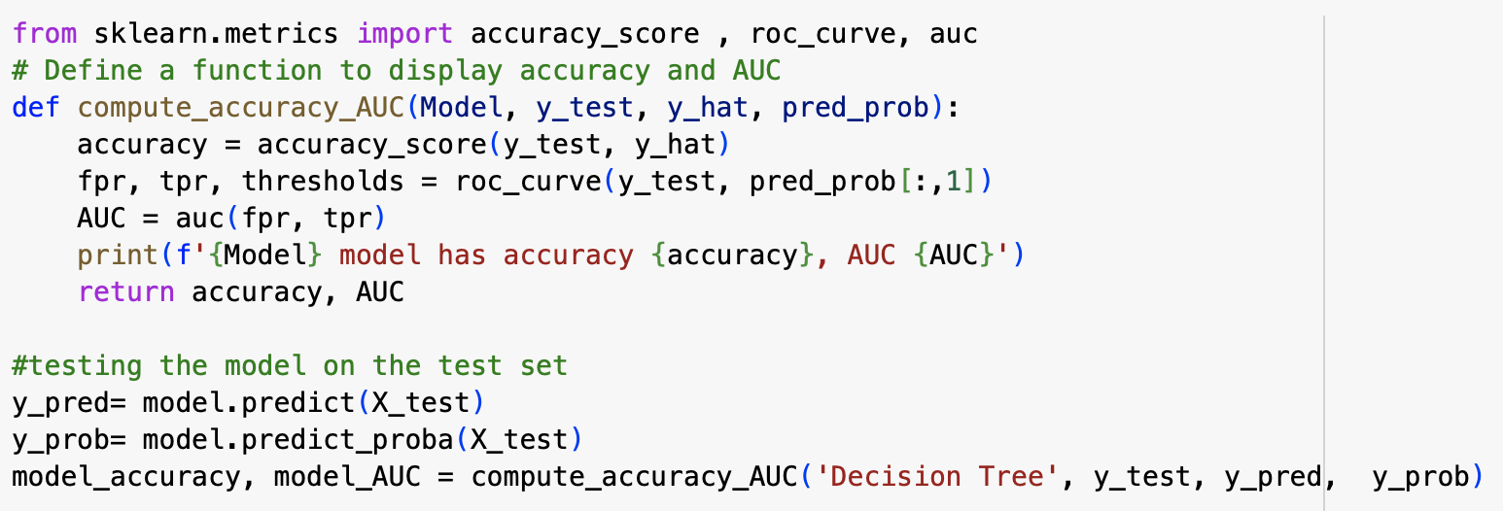
DECISION TREE
Fitting data with Decision Tree model
Flipkart Decision Tree
Visual Decision Tree model
MACHINE
LEARNING
HOME
INFO
DATAC
OVERVIEW
VISUAL
PROCESS
RESULTS

Slide 22
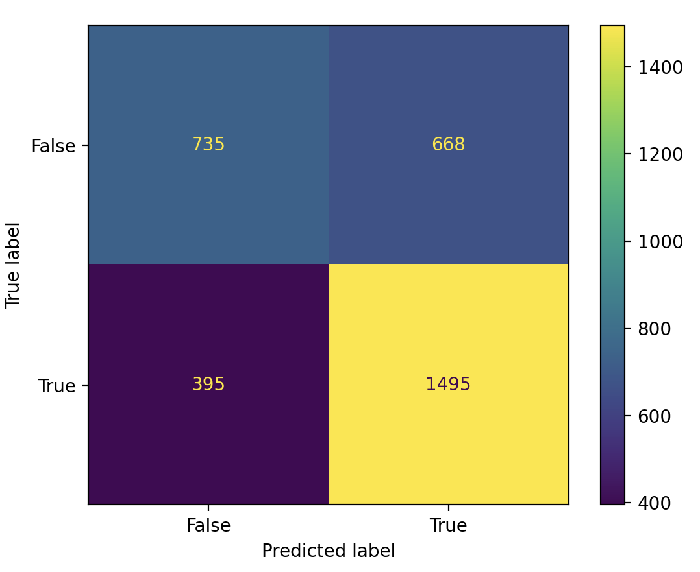
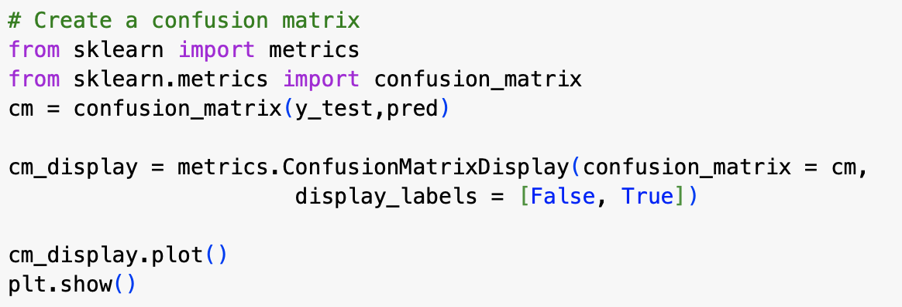
DECISION TREE
Flipkart Decision Tree
MACHINE
LEARNING
HOME
INFO
DATAC
OVERVIEW
VISUAL
PROCESS
RESULTS

Slide 23
DECISION TREE
DECISION TREE
CONCLUSION
Decision Tree- Confusion Matrix
The sentiment analysis using “decision tree” gives us the accuracy rate of 67.72% and AUC of 67.34%
It’s not a good rate.
Some further improvement can be made to improve the accuracy rate :
Drop the duplicate reviews
Relabel the data with 4 and 5 stars as “positive” reviews, and others as negative .
Using different ratio to split the data in training set and test set .
Using other machine learning method: Logistic Regression, Random Forest, SVM, Cross-Validation...
RESULTS
HOME
INFO
DATAC
OVERVIEW
VISUAL
PROCESS
TRAIN

Slide 24
DECISION TREE
CONCLUSION
The sentiment analysis using “decision tree” gives us the accuracy rate of 67.72% and AUC of 67.34%
It’s not a good rate.
Some further improvement can be made to improve the accuracy rate :
Drop the duplicate reviews
Relabel the data with 4 and 5 stars as “positive” reviews, and others as negative .
Using different ratio to split the data in training set and test set .
Using other machine learning method: Logistic Regression, Random Forest, SVM, Cross-Validation...
RESULTS
HOME
INFO
DATAC
OVERVIEW
VISUAL
PROCESS
TRAIN

